Slide 1

Inferencial Statistics
BMI 6106 2023

Slide 2
Outline
Hypothesis testing
Binomial test
One sample (Z test)
T-test
Two samples
Equal variances
Unequal Variances
Paired t-test
Anova
Multiple Comparisons
Post hoc analysis
False discovery rates
Non Parametric Statistics
Wilcoxon sign test
Kruskal-wallis test
Mann-Whitney test

Slide 3
Hypothesis testing
So far in the course we have covered a large suit of tools that will allows us to describe and understand our data and variables.
At this point we should be able to know:
What type/types of variables I have in my dataset
Their distributions
We can calculate parameters from these distributions (mean, sd, var), PMF, PDF, CMF, CDF.

Slide 4
Hypothesis testing
Population: REFERENCE GROUP, TARGET GROUP or STUDY GROUP is the entire group of interest
Random Sample: a selection of members of a population such that each member is chosen independently and has a non-zero probability of being chosen.
Blinding: A devise used in clinical trials to minimize bias. Double blind implies neither the administrating individual nor the receiving unit is aware of which treatment is being rendered. Single blind is when only the receiving unit is unaware of treatment.

Slide 5
Hypothesis testing
PARAMETER - numerical descriptive measure of a population. Because it is based on the observations in the population, its value is almost always unknown. Querying the population is usually not possible as it is too big.
ESTIMATOR - a rule or function (statistic) of the sample is called an estimator and is used to estimate a population parameter:
POINT ESTIMATOR - calculates a single number - mean, median, variance
INTERVAL ESTIMATOR - calculates an interval - confidence interval

Slide 6
Hypothesis testing
A Hypothesis is an educated guess about an observation or idea based on some evidence.
In hypothesis testing we want to test this idea using inferential (or Bayesian) tools to understand a particular phenomenon.
To test this idea, we compare a Null Hypothesis (default view of the unaltered model) against an alternative model (what might happen when I disturb the system)
Notes:
Now that we have the main elements of hypothesis testing, let’s define what is a hypothesis:
To test a hypothesis we need to stablish what is the default model also known as a null hupothesis

Slide 7
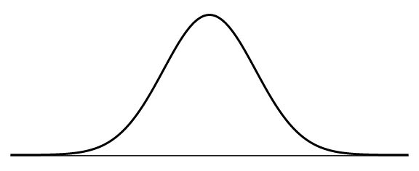
Hypothesis testing
We use estimators to test our hypothesis (mean, var,sd,CIs),
we evaluate where our estimator falls compared to a theoretical distribution or how different is from another estimator
Ok we defined our hypotheses, now we need to define how much error we are willing to allow in our model, we want to define a degree of confidence in our data.
This value is called alpha, in science a 95% degree of confidence is normally used which means an alpha of 0.05.
We need to convert our estimator to a value that can be compared against any another value within the distribution of interest, let’s look at an example…
Notes:
If the data falls within 95% of our distribution then we fail to reject the null hypothesis, if the

Slide 8
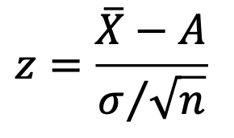
Hypothesis testing: One sample z test
If we have information about the population (mean and variance) we can infer how similar our sample estimator is to the population parameter using the z test:
Normal fasting glucose blood levels in a normal population have a mean of 85 mg/dl with a standard deviation of 15 mg/dl.
We sample a group of 30 individuals and find that they have a mean fasting glucose level of 100,
Ho: The sample mean is not different from the population mean
H1: The sample mean is LARGER than the population mean
One tail test
H1 > Ho
ᵅ = 0.05
Notes:
If the data falls within 95% of our distribution then we fail to reject the null hypothesis,
The assumptions of the one-sample z-test are:
The data are continuous (not discrete).
The data follow the normal probability distribution.
The sample is a simple random sample from its population. Each individual in the population has an equal probability of being selected in the sample.
The population standard deviation is known.

Slide 9
Hypothesis testing: One sample z test
Find the region of the distribution where we reject the null hypothesis (rejection region) outside of the 95% confidence.
We use the z table to find the z score at 0.05 for one tail test
In R we can do
This is the critical value, above this we reject the null hypothesis
Critical region
ᵅ = 0.05
qnorm(1-.05) = 1.644854
0
1.64
Notes:
If the data falls within 95% of our distribution then we fail to reject the null hypothesis,
https://sphweb.bumc.bu.edu/otlt/MPH-Modules/BS/R/R-Manual/R-Manual10.html critical tables in R

Slide 10
Hypothesis testing: One sample z test
The p-value is the area under the curve that follows the test statistic
P_value = 2.16e-08
In R:
1-pnorm(5.477226)
Find the test statistic using the z formula
100 Sample mean
85 population mean
15 SD
30 sample size
z= (100- 85) / (15/√30) = 5.477226
5.477226 > 1.65 We reject the null hypothesis
ᵅ = 0.05
0
1.64
5.47
Notes:
If the data falls within 95% of our distribution then we fail to reject the null hypothesis, if the

Slide 11
Hypothesis testing: One sample z test
The assumptions of the one-sample z-test are:
The data are continuous (not discrete).
The data follow the normal probability distribution.
The sample is a simple random sample from its population. Each individual in the population has an equal probability of being selected in the sample.
The population standard deviation is known.
Is instead of a one tailed test we don’t know which direction the difference is being tested we use a two tailed test
Critical region
qnorm(1-.05/2) = 1.959964
Critical region
ᵅ = 0.05
-1.96
0
1.96
Notes:
If the data falls within 95% of our distribution then we fail to reject the null hypothesis,
The assumptions of the one-sample z-test are:
The data are continuous (not discrete).
The data follow the normal probability distribution.
The sample is a simple random sample from its population. Each individual in the population has an equal probability of being selected in the sample.
The population standard deviation is known.

Slide 12
Hypothesis testing:
Ever other test that we will see from now on, behaves in the same manner. What changes is the manner in which the critical value is calculated
-1.96
0
1.96
Notes:
If the data falls within 95% of our distribution then we fail to reject the null hypothesis, if the

Slide 13
Binomial test
Well maybe not all test need a critical value….
For the binomial test the null hypothesis is simply that the probability that our observed number of successes is equal to an expected value
e.g. in 30 throws is collect 10 heads and 20 tails
Ho = 20 tails are not significantly different from the expected probability of 0.5 with an alpha 0f 0.05
Where n = 30 k = 20 p = 0.5, we can use the CMF to calculate the probability of finding up to 20 tails in 30 trials
2*(1-pbinom(19,30,0.5)) = 0.09873715 (P-value)
binom.test(20,30,0.5) = 0.09873715
Notes:
2*(1-pbinom(19,30,0.5)) = 0.09873715
binom.test(20,30,0.5) = 0.09873715

Slide 14
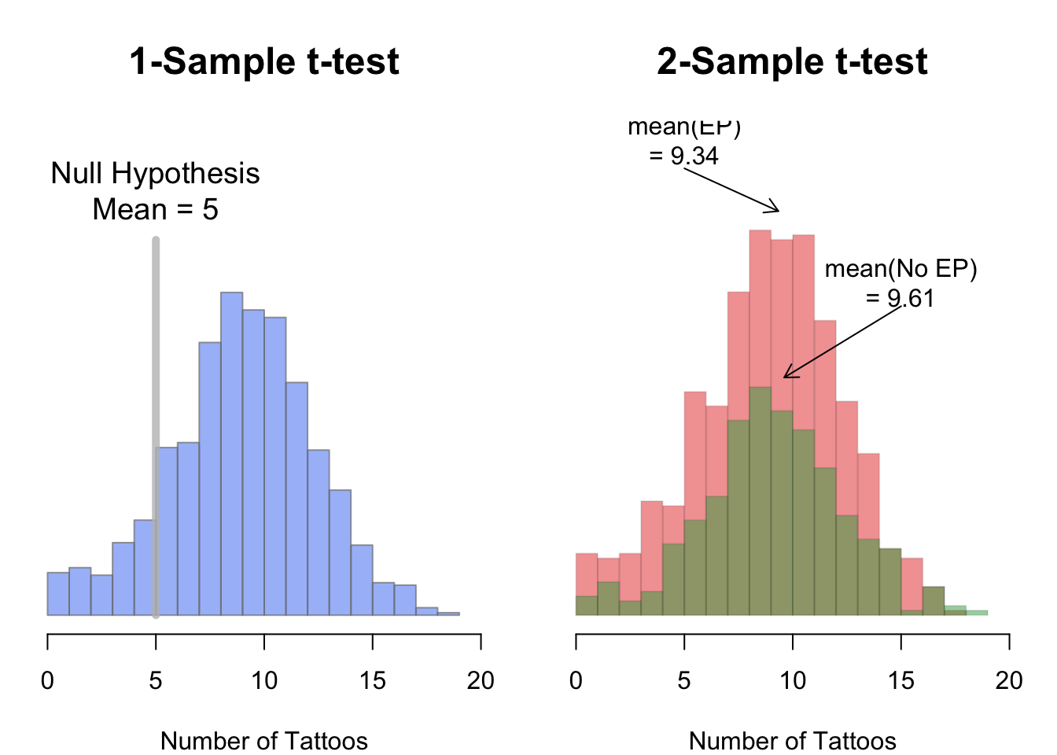
T-test
T test are one of the most used statistical test
It is used when we want to compare qualitative parameters (means) from two distributions
Three most used t-tests
t-test equal variance
t-test unequal variance
Paired t-test

Slide 15
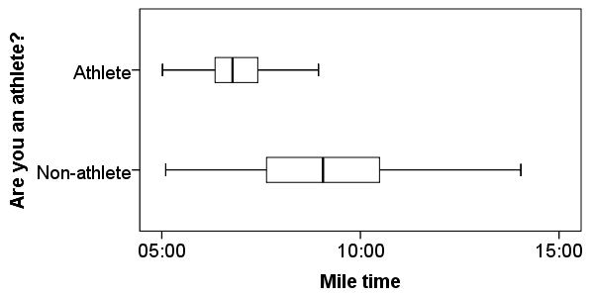
Equal variance
We can evaluate equal variances visually
Or statistically using the F test of equality
Of variance
In r we can use the function
If the test is non-significant we accept the Ho equal variances
var.test(A,B,conf.level = 0.95)

Slide 16
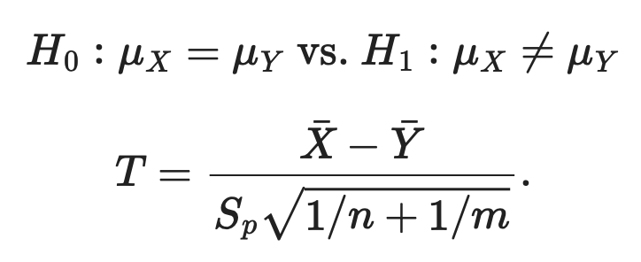
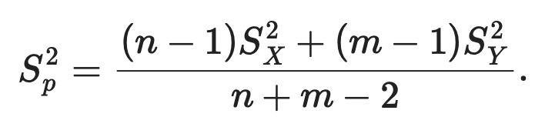
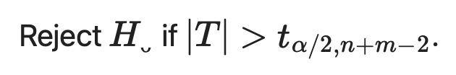
2 sample T-test Equal variance
The test statistic is
Difference of means
Shared variance between
the two samples
Where Sp² is the pooled variance
The test is significant if
Degrees of freedom
Notes:
See R example

Slide 17
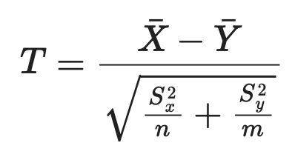
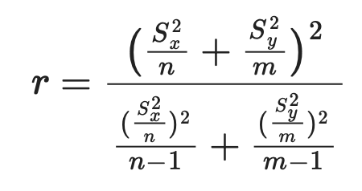
2 sample T-test Unequal variance
The test statistic is
And the degrees of freedom are defined as
Degrees of freedom
The test is significant if
Notes:
See R example

Slide 18
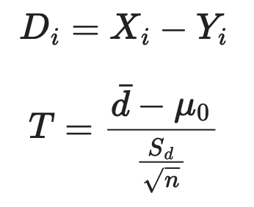
2 sample Paired T-test
Repeated Measurements: both treatments to same subjects, or follow subject over two time points
Remove the dependence between the two samples by subtracting each set of pair measurements
Then calculate the t statistic with n-1 degrees of freedom
Notes:
See R example: A school athletics has taken a new instructor, and want to test the effectiveness of the new type of training proposed by comparing the average times of 10 runners in the 100 meters. Are below the time in seconds before and after training for each athlete.

Slide 19
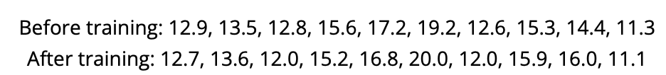
Example
A school athletics has taken a new instructor who wants to test the effectiveness of a new type of training by comparing the average times of 10 runners in the 100 meters. Below are the time in seconds before and after training for each athlete.
t.test(a,b, paired=TRUE)
t = -0.21331, df = 9, p-value = 0.8358

Slide 20
Anova (Analysis of Variance) Fisher 1918
Are there mean differences between 2 or more independent levels?
ANOVA works by decomposing the variance within the groups and across the groups, as well as the impact of the sample size in the variance.
One way anova has only one independent variable (with 2 or more groups) e.g. effect of Temperature on fruitflies growth (low, high, normal)
Two way anova has two or more independent variables e.g. effect of Temperature and photoperiod on fruitflies growth (low, high, normal) (12:12, 16:8, 8:16)
Notes:
Whatever the technique of data collection, the observations within each sampled population are normally distributed.
The sampled population has a common variance of s2.

Slide 21
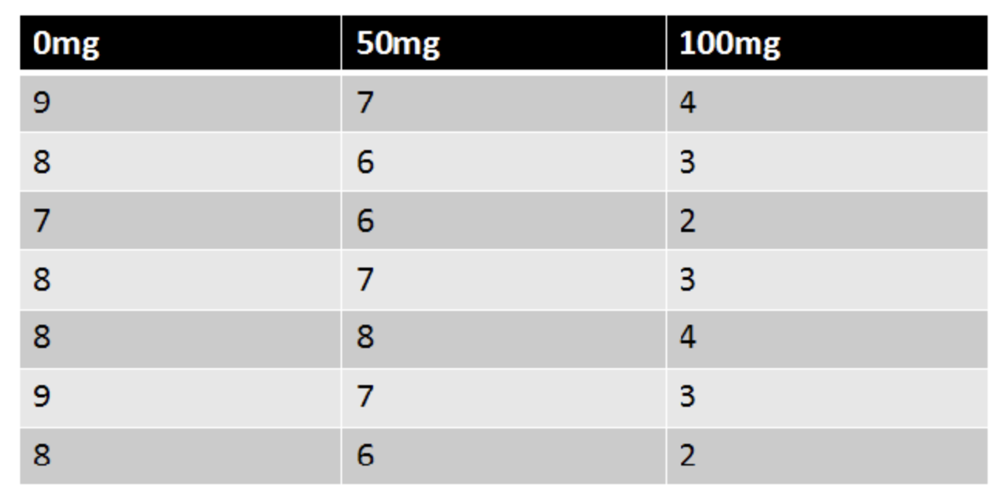
Example
Researchers want to test a new anti-anxiety medication. They split participants into three conditions (0mg, 50mg, and 100mg), then ask them to rate their anxiety level on a scale of 1-10.
Are there any differences between the three conditions using alpha = 0.05?

Slide 22
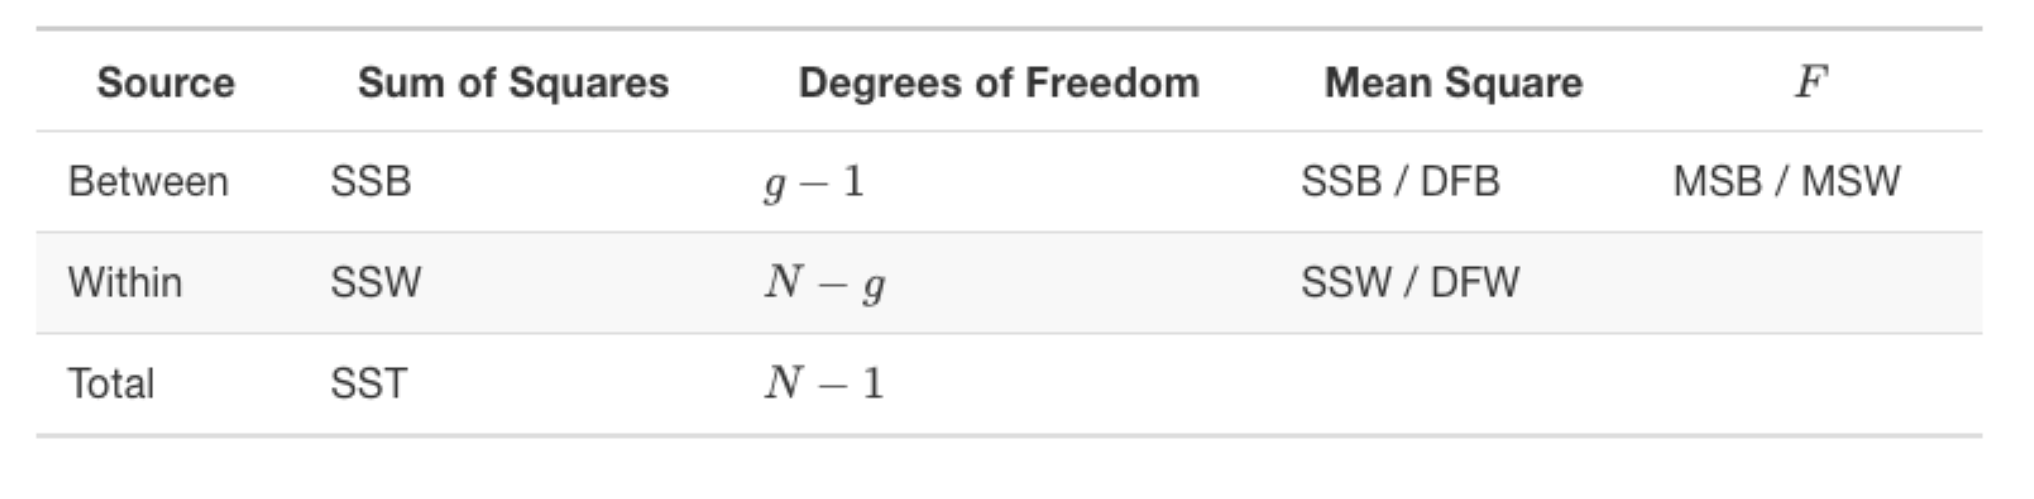
One way Anova (Analysis of Variance) Fisher 1918
To evaluate the null hypothesis we use the F statistic (Fisher)
F = MSB/MSW
MSB = Mean sum of squares due to treatment
MSW = Mean sum of squares due to error (within groups)
Anova Table
Notes:
Whatever the technique of data collection, the observations within each sampled population are normally distributed.
The sampled population has a common variance of s2.

Slide 23
Define Null and Alternative Hypothesis
Ho; μ_{0mg} = μ_{50mg} = μ_{100mg}
H₁; not all μ’s are equal
What is alpha?

Slide 24
Let’s calculate degrees of freedom
Between = g – 1 = 3 - 1 = 2
Within = N – g = 21 – 3 = 18
Total = N – 1 = 21 – 1 = 20
We can also calculate the critical value for the F distribution. We need the Between df = 2 and
Within df = 18
qf(0.95,df1 = 2,df2 = 18)
= 3.5546

Slide 25
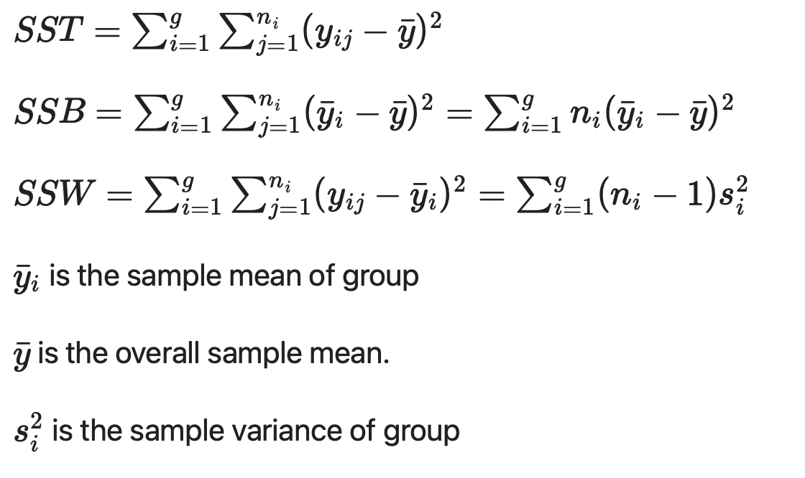
Notes:
Whatever the technique of data collection, the observations within each sampled population are normally distributed.
The sampled population has a common variance of s2.

Slide 26
Sum of squares within (SSW):
For each subject, compute the difference between its score and its group mean.
Square all these differences
Sum the squared differences
= 10.29
Notes:
Whatever the technique of data collection, the observations within each sampled population are normally distributed.
The sampled population has a common variance of s2.

Slide 27
Sum of squares between (SSB):
For each subject, compute the difference between its group mean and the grand mean. The grand mean is the mean of all N scores (just sum all scores and divide by the total sample size N)
Square all these differences
Sum the squared differences
= 98.67
Notes:
Whatever the technique of data collection, the observations within each sampled population are normally distributed.
The sampled population has a common variance of s2.

Slide 28
Sum of squares Total (SST):
For each subject, compute the difference between its score and the grand mean
Square all these differences
Sum the squared differences
= 108.95
Notes:
Whatever the technique of data collection, the observations within each sampled population are normally distributed.
The sampled population has a common variance of s2.

Slide 29
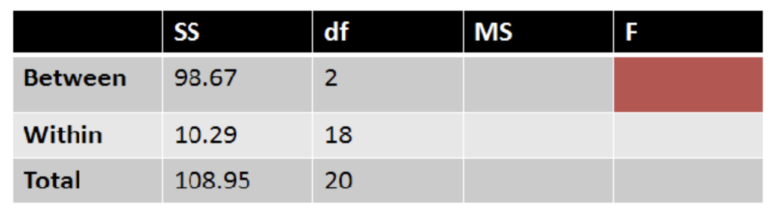
So far we have..
Now we find each MS by diving each SS by their respective df

Slide 30
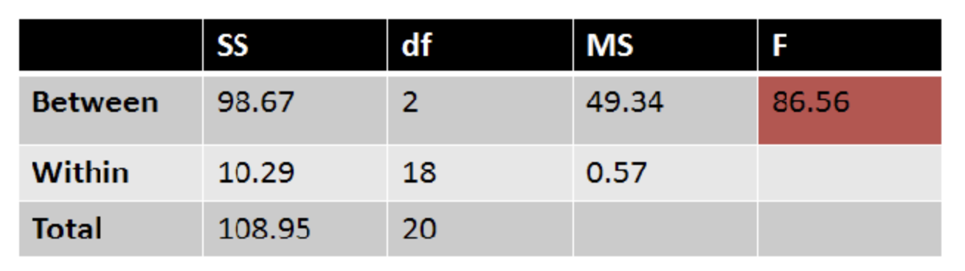
And finally, we can calculate our F:
Now we find our F statistic by dividing MS Between / MS Within

Slide 31
And finally, we can calculate our F:
Because 86.56 > than 5.44 then we reject our Ho and conclude that the three conditions differed significantly on anxiety level, F(2, 18) = 86.56, p < 0.05.
We can find the p-value in R
2*(1-pf(86.56, df1 = 2,df2 = 18)) = 1.166077e-09

Slide 32
Assumptions
The observations are obtained independently and randomly from the population defined by the factor levels
Factor levels are normally distributed.
These normal populations have a common variance. (Levene’s test can be used to check this.)
Notes:
Whatever the technique of data collection, the observations within each sampled population are normally distributed.
The sampled population has a common variance of s2.

Slide 33
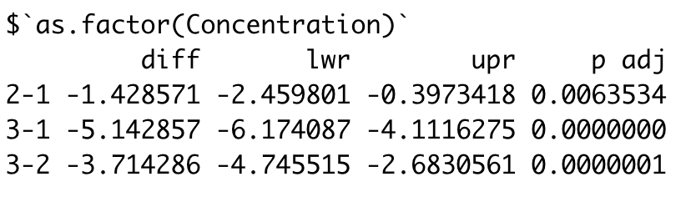
Anova (Analysis of Variance) Fisher 1918
The problem with the ANOVA is that it tells you if the levels are different, but it does not tell you which groups are significantly different.
To get to this you need to run a post hoc test (tukey’s post hoc) to statistically compare each pair wise combination (or selected pairs) in the analysis.
tukey.one.way <- TukeyHSD(one.way)
Notes:
Whatever the technique of data collection, the observations within each sampled population are normally distributed.
The sampled population has a common variance of s2.

Slide 34
Anova
Other type of ANOVAS:
Manova (Multivariate Analysis of Variance - multiple dependent variables)
Repeated Measurement ANOVAS
Factorial ANOVAS

Slide 35
Multiple Comparisons
We saw in the t-test and the anovas that we could run many t-test from the same analysis (pair wise comparisons across factors, or all combinations within anovas in the post hoc test).
To avoid running the risk of a type I (false positive) and type II errors (false negative) we run a correction or adjustment to the pvalues that reflect the multiple comparisons.
There are a lot!! of adjustment techniques, the two most common are
Bonferroni alpha/number of comparisons – more conservative
FDR False discovery rate (percentage of acceptance of false positives) more flexible
Good paper on the subject with much more info 10.21037/jtd.2017.05.34

Slide 36
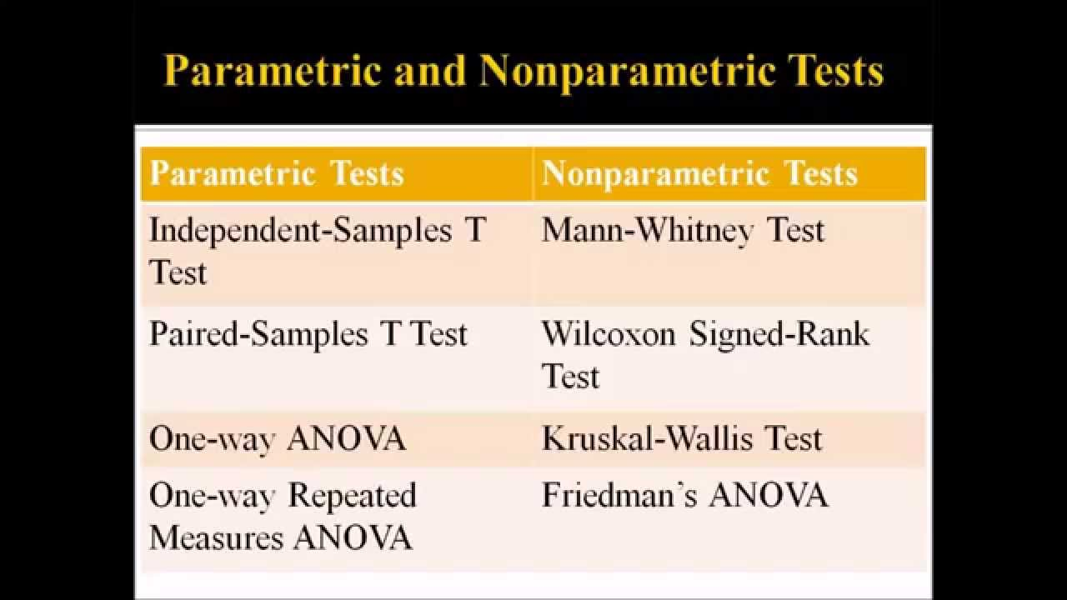
Non Parametric Statistics
If our assumptions of normality break down or we have low sample sizes (qqplot, Kolmogorov–Smirnov test, density plots, histograms) then we can use non parametric statistics that use rank estimators (Median) to evaluate significance:
Mann-Whitney test
Wilcoxon Signed Rank test
Kruskal-Wallis test

Slide 37
Mann-Whitney test
Ho: The two populations are equal
H1: The two populations are not equal
This test corresponds to the two independent samples t-test

Slide 38
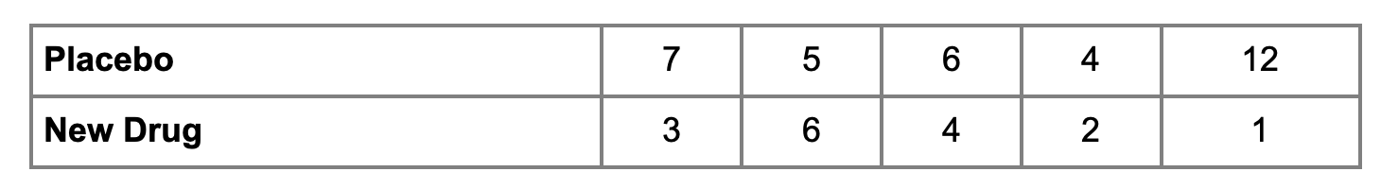
Mann-Whitney test
Example: We want to investigate the effectiveness of a new drug to reduce symptoms of asthma in children.
A total of n=10 participants are randomized to receive either the new drug or a placebo.
Participants are asked to record the number of episodes of shortness of breath over a 1 week period following receipt of the assigned treatment. Partial data is shown below.
Modified from https://sphweb.bumc.bu.edu/otlt/mph-modules/bs/bs704_nonparametric/bs704_nonparametric4.html

Slide 39
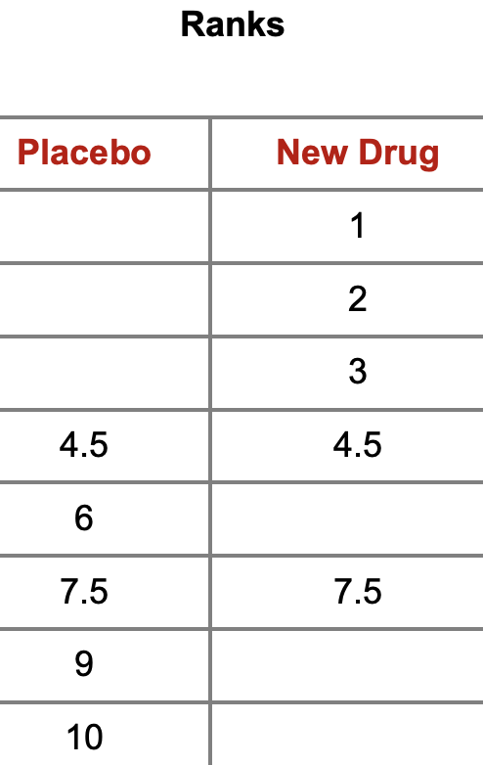
Mann-Whitney test
1. Sort values from both groups from largest to smallest and assign ranks from the position of the pooled data.
E.g. 1 is the smallest value so it has a rank of 1, 2 and 3 also have their own ranks, but 4 is seen 2 times then its rank is the mean between the next two ranks (4 and 5)= 4.5, then we get, 5 that has the next available rank 6, 6 is also seen twice then it gets the rank of 7.5, then 7 and 12 with a rank of 9 and 10.
2. Sum the ranks for each group: Placebo 37, New drug 18
Sum =
37 18
Modified from https://sphweb.bumc.bu.edu/otlt/mph-modules/bs/bs704_nonparametric/bs704_nonparametric4.html

Slide 40
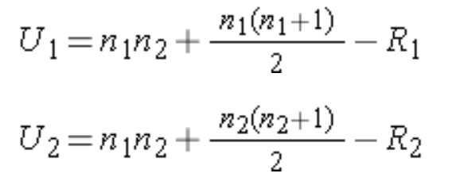
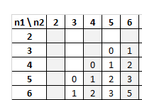
Mann-Whitney test
We call Ri the sum of ranks for each group
U1 = 3
U2 = 22
We select the smaller U = 3; This is our Ustat
To get the U critical we find the value in the U table for 5 and 5 df = 2
Rejection Criteria: Reject Null Hypothesis if Ustat < Ucrit
Because 3 > 2 then we fail to reject the Null Hypothesis.
Modified from https://sphweb.bumc.bu.edu/otlt/mph-modules/bs/bs704_nonparametric/bs704_nonparametric4.html

Slide 41
Non Parametric Statistics
If our assumptions of normality break down or we have low sample sizes (qqplot, Kolmogorov–Smirnov test, density plots, histograms) then we can use non parametric statistics that use rank estimators (Median) to evaluate significance:
Mann-Whitney test
Wilcoxon Signed Rank test
Kruskal-Wallis test

Slide 42
Wilcoxon sign rank test
Paired samples similar to the paired t-test
In this case we also use ranks, but in this case we use the absolute value of the differences between the two groups for ranking
Then we add the sign (- or +) based on the sign of the difference
We add all the - and + independently and choose the lowest value
Compare the smallest value to the W critical value
Ho: The median differences is zero
H1: The median differences is positive

Slide 43
Player | Before | After | Difference | Abs Difference | Rank | With Tied Ranks | Negative Ranks | Positive Ranks
Player #2 | 17 | 17 | 0 | 0 |  | -
Player #4 | 15 | 15 | 0 | 0 |  | -
Player #1 | 14 | 15 | -1 | 1 | 1 | 3 | -3
Player #8 | 13 | 14 | -1 | 1 | 2 | 3 | -3
Player #10 | 15 | 16 | -1 | 1 | 3 | 3 | -3
Player #11 | 19 | 18 | 1 | 1 | 4 | 3 |  | 3
Player #15 | 16 | 17 | -1 | 1 | 5 | 3 | -3
Player #5 | 15 | 17 | -2 | 2 | 6 | 6.5 | -6.5
Player #9 | 13 | 11 | 2 | 2 | 7 | 6.5 |  | 6.5
Player #3 | 12 | 15 | -3 | 3 | 8 | 9 | -9
Player #7 | 12 | 9 | 3 | 3 | 9 | 9 |  | 9
Player #12 | 17 | 20 | -3 | 3 | 10 | 9 | -9
Player #14 | 14 | 10 | 4 | 4 | 11 | 11 |  | 11
Player #6 | 9 | 14 | -5 | 5 | 12 | 12 | -12
Player #13 | 14 | 20 | -6 | 6 | 13 | 13 | -12
 |  |  |  |  |  | SUM | -60.5 | 29.5
To Calculate the ranks with ties always find the mean of the rank.
e.g. for the 5 ones, their ranks are 1,2,3,4,5
The mean of that vector is 3
wilcox.test(Before, After, paired = T)
V = 29.5, p-value = 0.275

Slide 44
Non Parametric Statistics
If our assumptions of normality break down or we have low sample sizes (qqplot, Kolmogorov–Smirnov test, density plots, histograms) then we can use non parametric statistics that use rank estimators (Median) to evaluate significance:
Mann-Whitney test
Wilcoxon Signed Rank test
Kruskal-Wallis test

Slide 45
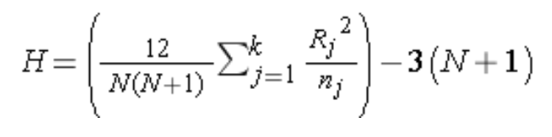
Kruskal-Wallis test
Comparable to an ANOVA where we have more than 2 independent samples
H₀: The k population medians are equal
H₁: The k population medians are not all equal
Exactly the same procedure as the U test, but we are getting more than 2 sums of ranks (r)
We compute the H statistics with the formula
We compare the H with the critical
value of the H table
N is the total number of observations across all groups,
R_{i} is the sum of ranks of observations in the ith sample,

